Slide 1
Systematic Errors in PICO
Brendan Crill
(Jet Propulsion Laboratory / California Institute of Technology)
3 May 2018
© 2018 California Institute of Technology. All rights reserved. Government sponsorship acknowledged.
Cleared for public release CL#18-2063.
The decision to implement PICO will not be finalized until NASA’s completion
of the National Environmental Policy Act (NEPA) process. This document is being made available
for information purposes only.

Slide 2
Workshop Deliverables
How far do we want, and is it realistic, to push systematic control? Need to have a plan for each of the systematic effects we are analyzing as to how it moves forward, and what is the end goal.
The talks need to explain where we are with each of the effects, what has been done, and what is the plan ahead.
Each of the analyses will include simplifications. Need to be clear about the simplifications, highlight what additional complexity is still feasible, and what we learn with what we have so far.
The effect of 1/f and correlated noise - what do we know from Planck/CORE? Do we need end-to-end simulations?

Slide 3
PICO systematics WG approach
Achieving 0.6 μK arcmin polarization sensitivity requires control of systematic errors to better than that level.
Depend on specific mission and instrument design: orbit and observation parameters, instrument technology (detectors, cryogenics, readout, optics incl. modulators), telescope design, solar cycle, etc..
Post-processing of mission data plays a critical role
PICO systematic WG asked ourselves what systematics studies are necessary for:
  Informing the notional mission/instrument design as it develops.
  Building a convincing case in the PICO report that systematic errors can be understood and controlled to the necessary level.
Keep in mind that systematics are likely to limit the final sensitivity of the mission, but an L2 orbit is a fantastic place for CMB observation

Slide 4
Systematics List
The PICO systematics WG listed known systematic errors
https://zzz.physics.umn.edu/ipsig/preliminary_list_of_systematic_effects_to_consider
All of the listed systematics are difficult to manage at the required level
To focus the work for the PICO study, we prioritized the list based on past experience.
  “Systematics Risk Factor” assigned: includes impact on science results, difficulty in mitigating through instrument/mission design or analysis, and whether the particular systematic is well understood.
  Highest risk systematics are ones that are mission design-driving and/or not well understood
Many of these systematics could be reduced with a fast modulator, though with possible introduction of additional modulator-synchronous systematics

Slide 5
Pair Differencing
Bandpass mismatch
Beam mismatch
Gain mismatch

Slide 6
Optics
Instrumental Polarization
Cross polarization
Pointing jitter
Main/near sidelobe beam shape
Far sidelobe
Chromatic beam shape

Slide 7
Detectors
Time response accuracy & stability
Readout cross talk
Polarization angle
Gain stability
Detector nonlinearity
Cross-correlated noise
  Residual correlated cosmic ray hits
  Thermal common mode noise
  Electrical/mechanical/thermal pickup from on-board vibrations
ADC nonlinearity

Slide 8
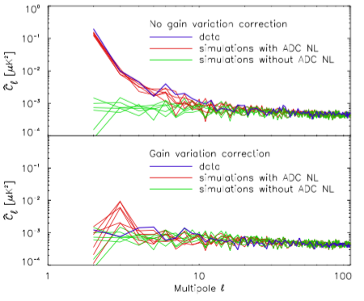
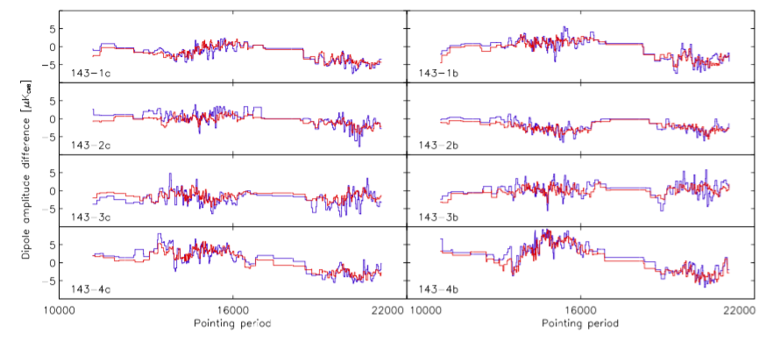
Detector gain stability
Planck HFI
No correction for
variable “gains”
After correction
Drifts in time in relative gain of detectors leaks temperature signal to polarization
HFI on average achieved mission average better than 10⁻⁴ relative calibration uncertainty
Planck (both LFI and HFI) gained experience correcting time-variable gain
  A relevant note: HFI “gain variation” was never actually detector response variation, it was always something else (in particular, ADC nonlinearity)
Simulations underway given PICO scan strategy, will measure S/N of gain reconstruction (mainly using CMB dipole) using Planck code.
  You’ll hear from Maurizo shortly: What is the level to which the gain can be measured on various time scales?
NOTE: fast modulation helps with relative gain mismatch but not at an individual detector level

Slide 9
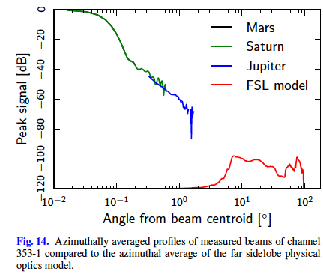
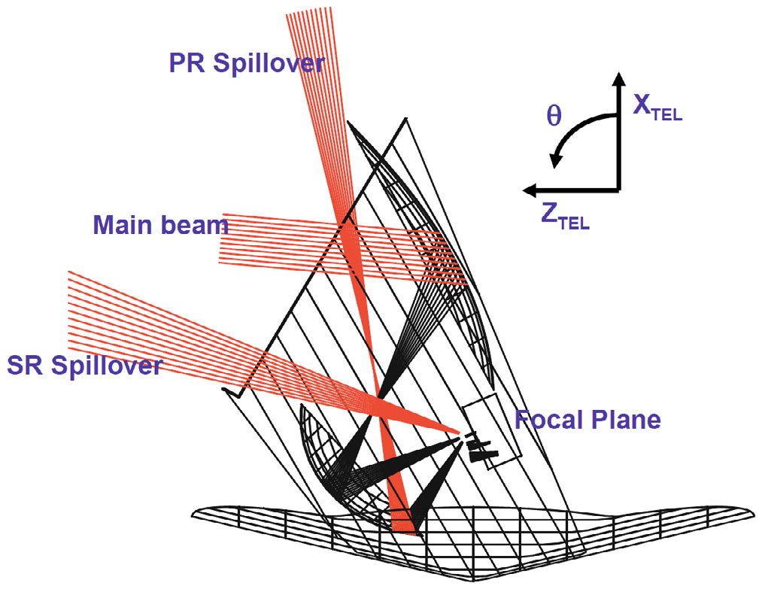
Far sidelobes
Difficult to measure accurately on ground: rely on models (i.e. GRASP or other physical optics code)
Very low level compared to main beam (though large solid angle)
Typically highly polarized
Picks up bright far off-axis signals, i.e. galaxy in a scan-synchronous way
PICO study using GRASP simulations to estimate FSLs of telescope, and use Planck simulation tools to compute sky signal pickup with PICO’s scan, map making, etc.
Room for improvement with design
NOTE: fast modulation doesn’t completely mitigate this effect. It helps with any differential FSLs
PR spillover
SR spillover

Slide 10
Polarization Angle Calibration
Refers to knowledge of angle of sensitivity of detectors
Relative angle between the different photometers can be calibrated to high precision in the limit that single photometers are independent, but absolute angle
With Planck, we were never successful at finding an astrophysical source for polarization angle calibration that is free from systematics. Great effort went into characterizing the Crab nebula (Tau A).
HFI confirmed ground calibration results (Rosset et al 2010) to ~0.2 degrees by checking whether TB, EB are zero. (Planck Intermediate results XLVI 2016) No additional rotation needed.
  Typical scheme for ground-based instruments as well
  Spectral shape of angle error may not be completely degenerate with scientific signal in TB or EB
NOTE: fast modulation doesn’t help with this: must calibrate absolute angle of modulator.
Other ideas: external calibration satellite…?

Slide 11
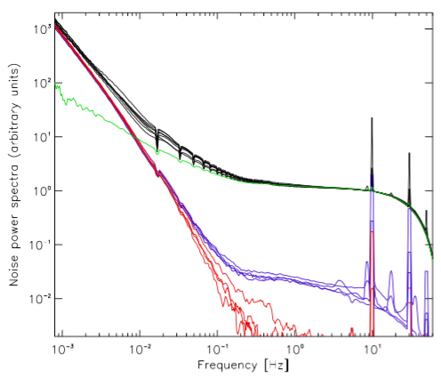
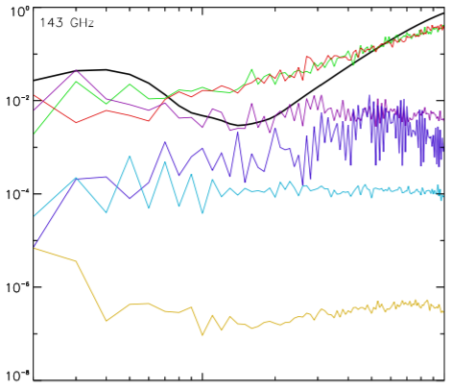


1/f and correlated noise in Planck/HFI
E-mode signal on 50% sky
Noise PSD of 143GHz bolometers
8 polarization sensitive (PSB), 3 total power-only (SWB)
After decorrelation of low-frequency drift and
Use of destriping map-maker
Spin freq.
Noise
Residual 1/f
uncorrelated
Detector to detector
“4K lines”
Auto spectra
PSB-pair cross spectra
SWB cross spectra

Slide 12
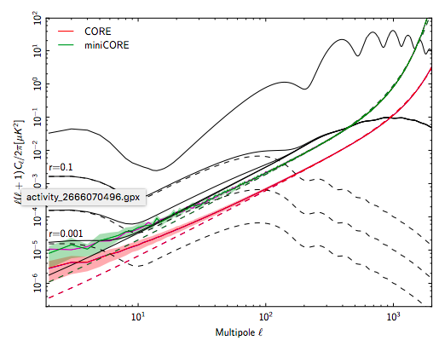
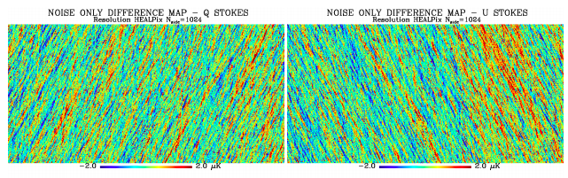
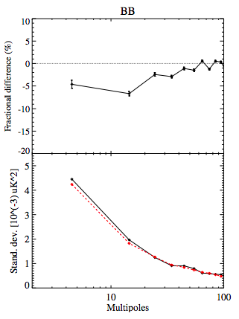
CORE simulations
Cross-Correlated noise
1/f noise
Residuals due to not taking into account cross-correlated
noise
HFI 143 GHz
Slight change in noise power when accounting for cross-correlated noise
50 mHz knee freq
Fig. 10 of Natoli et al. (2017) astro-ph/1707.04224

Slide 13
Plans going forward
today May 3 Systematics WG meeting after workshop ends
Most simulation work wrapped up this summer
September 2018 (?) Draft systematics document
December 2018 PICO report due
  3 pages specifically on systematics in report
March 2019 short whitepaper on systematics control for an imaging CMB space mission

Slide 14
What are the key points to make in the report about systematics?
Emphasize the benefits of a space observatory at L2
A condensed version of the systematics table with estimates of
+ present the results from the calculations we are able to do
Some points about the next steps towards PICO
  In order to help set requirements on systems, subsystems and components and need further software infrastructure development for simulating mission data and performing systematics mitigation (leverage existing that has been coming together for Planck, LiteBird, S4, etc.)
  Optical model to study beam, sidelobes

Slide 15
Proposed Agenda for Face-to-face
Review feedback from the workshop
Any additional updates on ongoing work
Review the systematics document outline
What key points should we make in the PICO report?
Near-term plan

