Slide 1
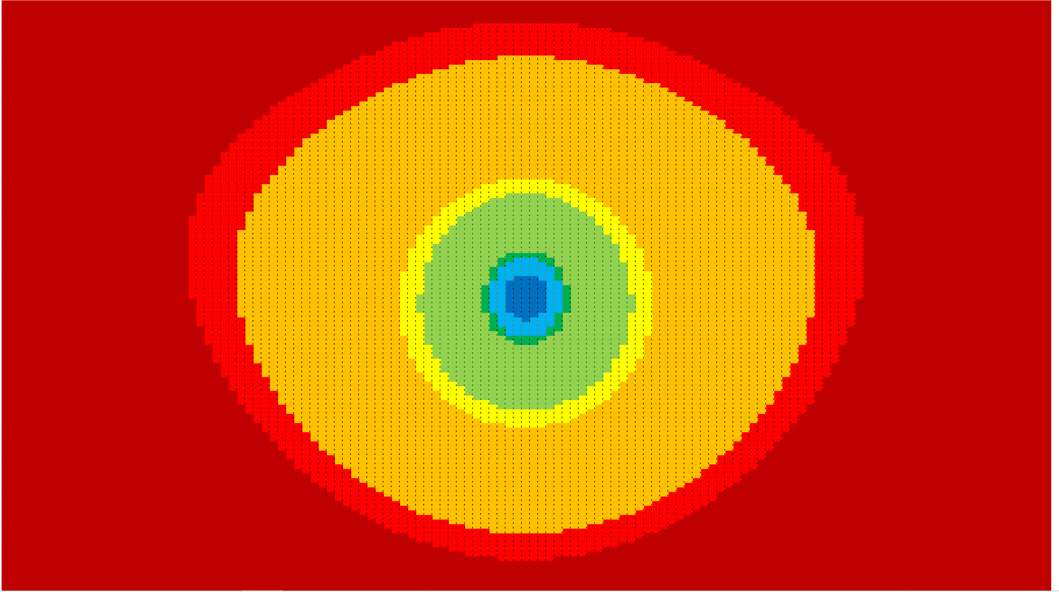
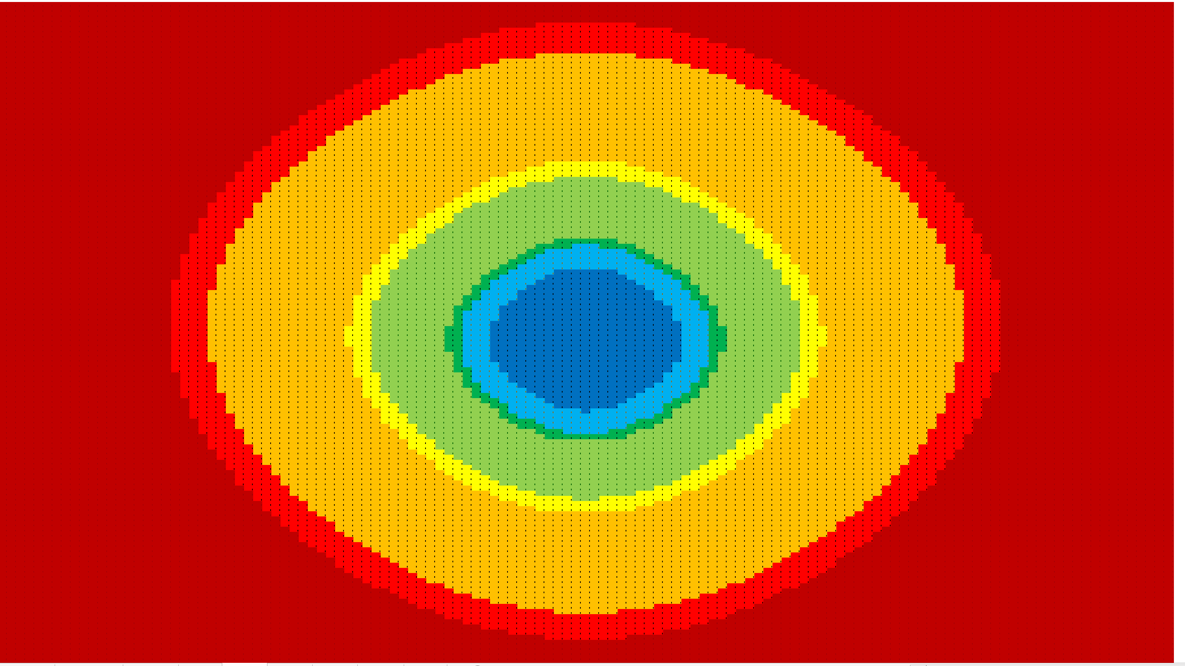
I have tried the coma correction process on V3D Open Design.
Now using Zernike Polynomials offset to the centre of each mirror
DLFOV plot is 30 by 15 deg
Un-corrected above
Corrected below
Colours are 80% Strehl at 48, 58,
145, 174, 433, 520 and 899GHz
Increase is mostly at high
frequencies x10 at 899GHz

Slide 2
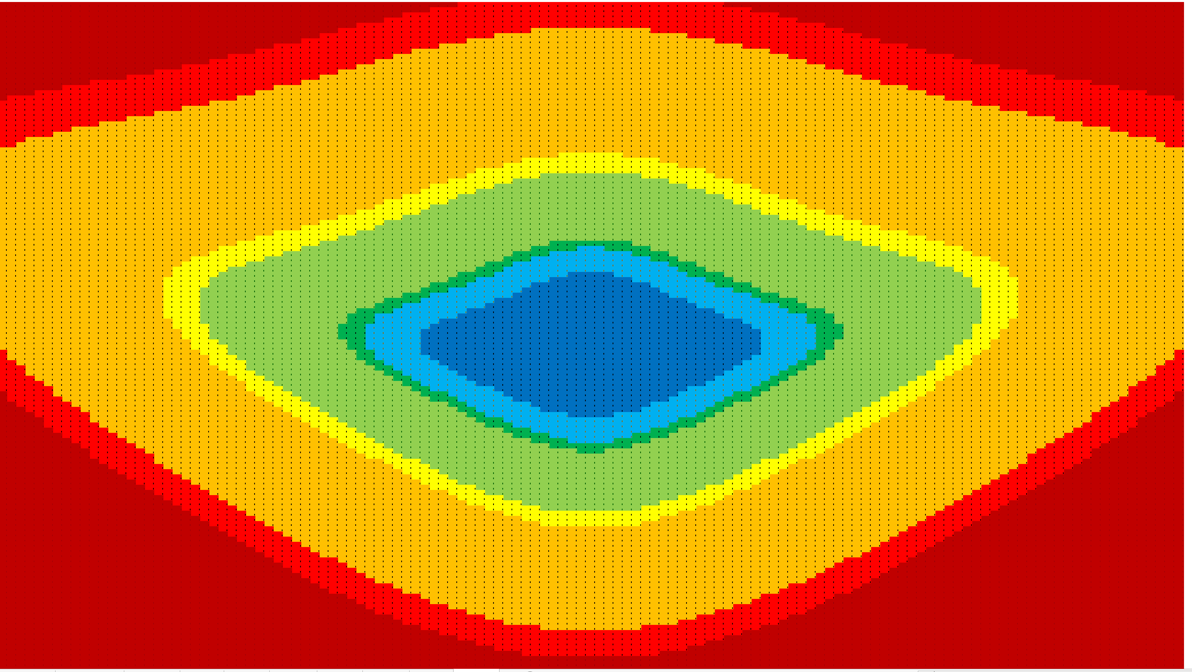
Can get further increase at all frequencies if you allow a curved focal plane.
Radius of Curvature ~3m
Convex: ~10mm at 7.5deg
To use all of this at the low
frequencies you would need
to make the mirrors and the
FP wider in the along scan
direction.
Funny shape is pattern on
sky and this is related to
distortion – see next slide.
The region of the focal plane
that you would populate is
more or symmetrical in both
directions.

Slide 3
Other Comments about the Open Design
It has rather large distortion
  Plot of actual position in focal plane
  compared to paraxial positions
  Is this a problem?
  Might it be associated with relatively
  high cross-pol off axis?
Telecentricity is imperfect and varies over field
  Plot of rays from secondary extended
  back to 3m plane
  Means that illumination of stop will
  be somewhat off center for off-axis
  beams.
  Consequences for beam shape, sidelobes
  and perhaps polarization?

