Slide 1
Dust Polarization in Galactic Clouds with PICO
Peter Ashton
UC Berkeley/LBNL
2 May 2018

Slide 2
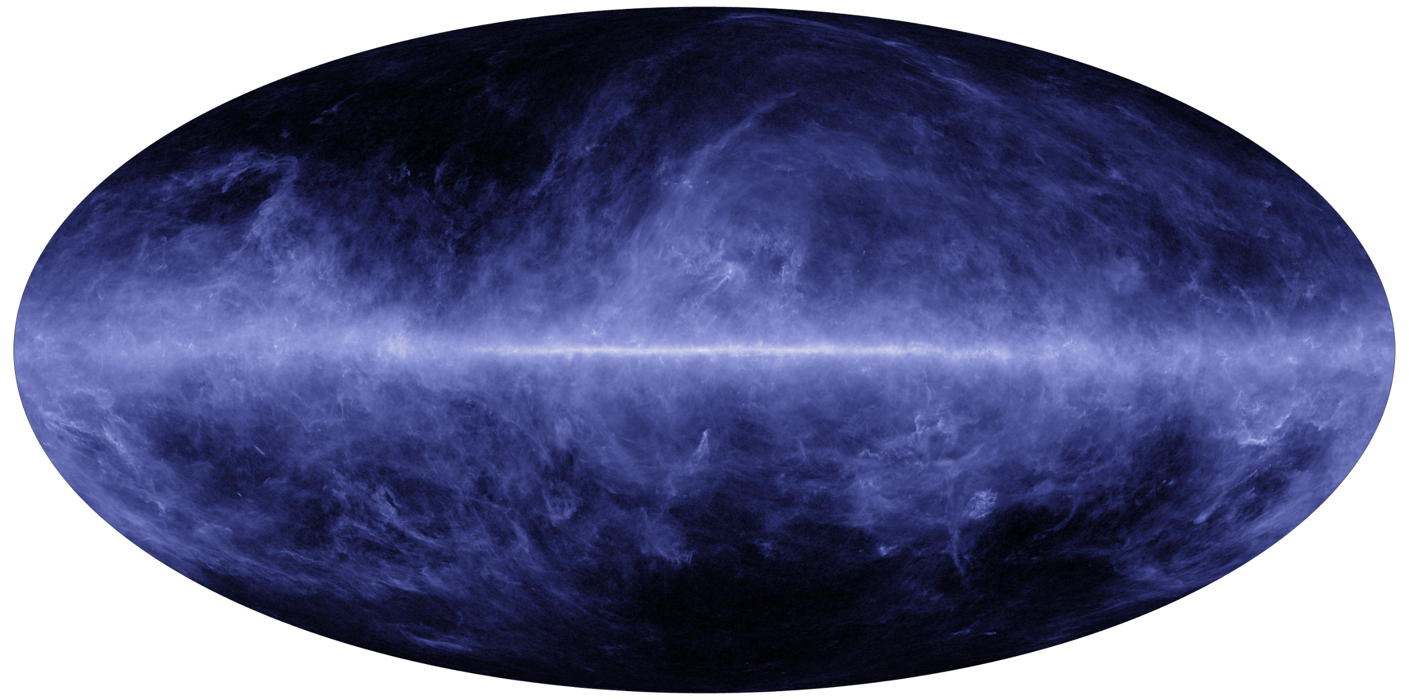
Dust is everywhere…
Planck Thermal Dust

Slide 3
3 Questions
What do we know about interstellar dust?
How can we use polarimetric observations of clouds to probe dust properties?
How can PICO help?

Slide 4
What do we know about interstellar dust?
Composition
  From near-IR emission/absorption lines, dust contains silicate and carbonaceous compounds.
  Other “metals” e.g. magnesium, iron
Temperatures
  From SED fitting (e.g. Planck, Herschel, IRAS, etc.) temperatures generally range 16-20 K, colder inside dense molecular clouds
  Depends on material; e.g. carbon grains stay a few degrees warmer than silicate grains
  Larger grains tend to be cooler due to relatively higher emission efficiency.
Grain size distribution
  Typical radii from 0.05 µm to 0.2 µm
  Separate population of very small grains -> polycyclic aromatic hydrocarbons (PAHs)
Thermal emission from dust grains is polarized (to varying degrees).
  Implies a preferential alignment of grains with their local magnetic field.

Slide 5
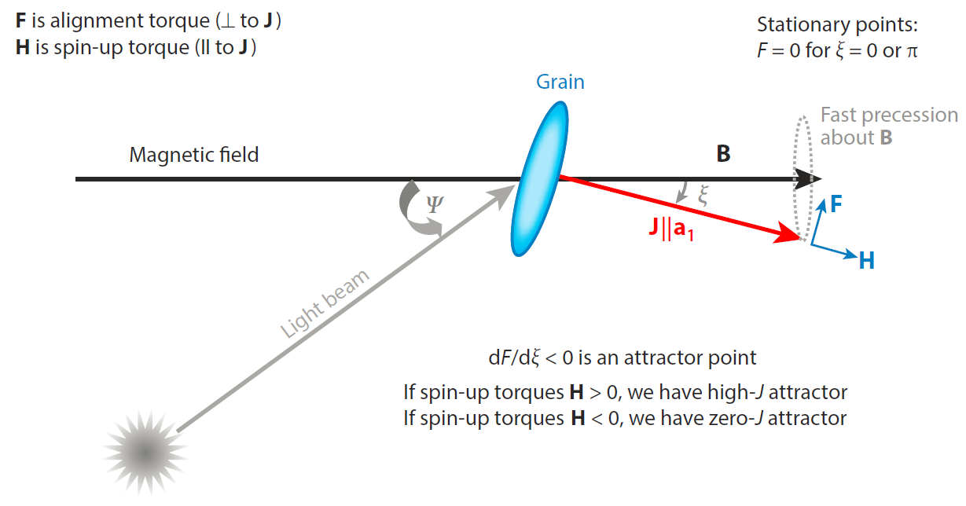
The power of polarized dust observations
In Radiative Alignment Torques (RATs) paradigm, chiral dust grains gain angular momentum from photons in an anisotropic radiation field.
Variations in alignment efficiency vs. another variable means polarization selects out a sub-population of grains.
Lazarian & Hoang (2007)

Slide 6
Diffuse molecular gas: A_{V} ~ 0.25 - 2 mag
Dense molecular gas: A_{V} ~ 3 - 10 mag
Diffuse atomic gas: A_{V} < 0.1 mag
Visual extinction maps approximately linearly to column density: A_{V} = 1 mag => N_{H} = 2e21 cm⁻²
Star formation: A_{V} > 10 - 20 mag

Slide 7
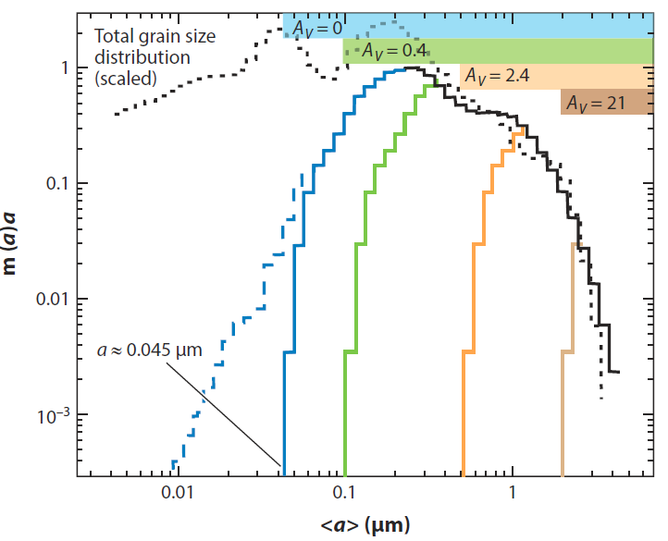
Example: Loss of Alignment with Shielding
If alignment process is associated with radiation, alignment trends will be related to optical properties of dust grains.
In RATs picture, alignment is most efficient if a > λ/2 where a is effective grain radius.
Small grains remain unaligned because interstellar radiation field lacks UV wavelengths.
  In diffuse ISM, cutoff at half the Lyman limit wavelength.
Deeper in cloud, bluer wavelengths are progressively extincted, and only larger grains remain aligned.
Adapted from Kim & Martin (1995)

Slide 8
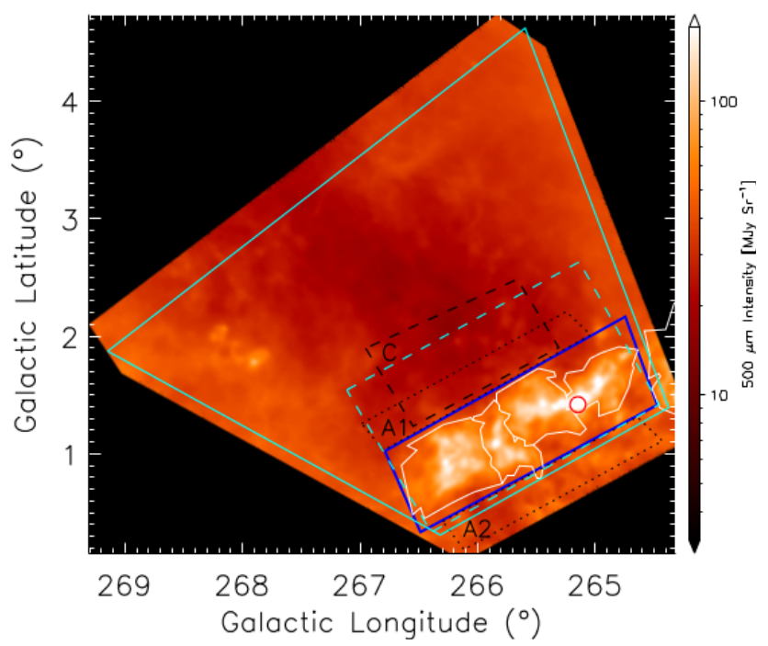
BLASTPol 2012
Launched December 26, 2012 from McMurdo Station, Antarctica
  16 day flight
Altitude ~38 km (~120,000 ft)
  Above 99.5% of atmospheric water vapor
Main science target: the Vela C molecular cloud and surroundings
Measure Stokes I, Q, and U at 250, 350, and 500 µm
Fissel et al. (2016)

Slide 9
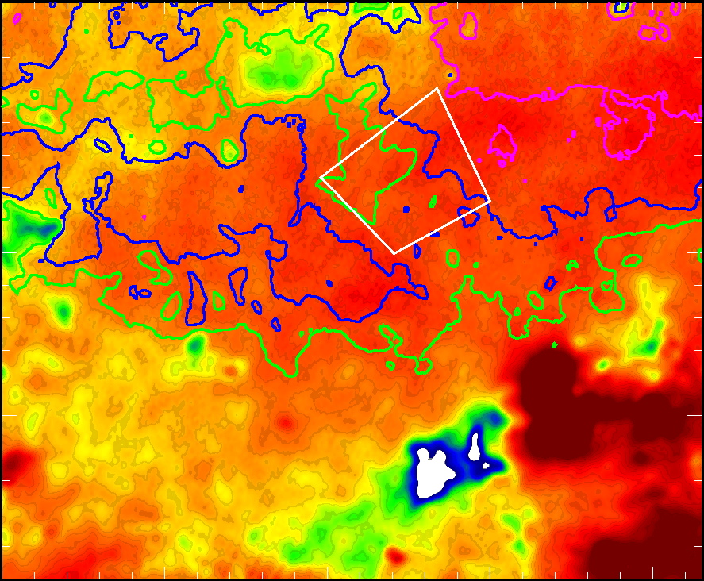
Target Object Properties
N_{H}
p₈₅₀
Peak N_{H} ~ 1 x 10²² cm⁻²
Background subtracted center-to-edge A_{V} ~ 1.3 mag
Linear-scaled T_{D} from 15 to 20 K
Contours of N_{H}

Slide 10
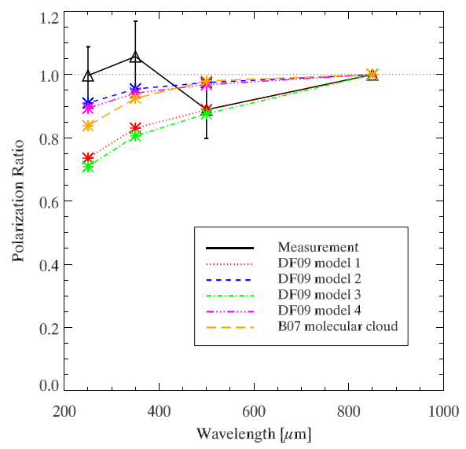
Translucent Molecular Cloud Polarization Spectrum
799
666
555
462
385
321
GHz
p(λ) = P(λ)/I(λ)
  Here, normalized to p(850 µm)
Near peak of thermal emission, we effectively probe relative temperature of aligned grains vs. all grains.
  A flat submm polarization spectrum implies temperatures are nearly equal.
Implications for variation in dust emissivity vs. material, grain size, shielding, etc.
Ashton et al. (2018)

Slide 11
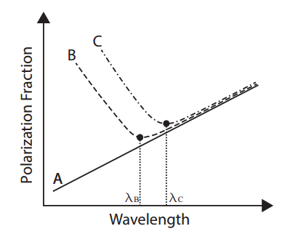
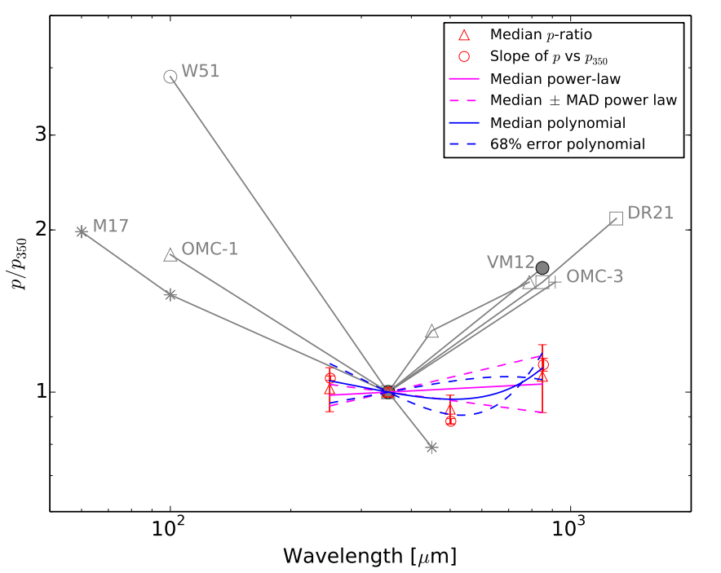
Pol spec dependence on environment
Uniform, cool, poorly-aligned dust in cloud
Warm, well-aligned dust near embedded sources
Vallaincourt & Matthews (2012)
Gandilo et al. (2016)
Zeng et al. (2013)

Slide 12
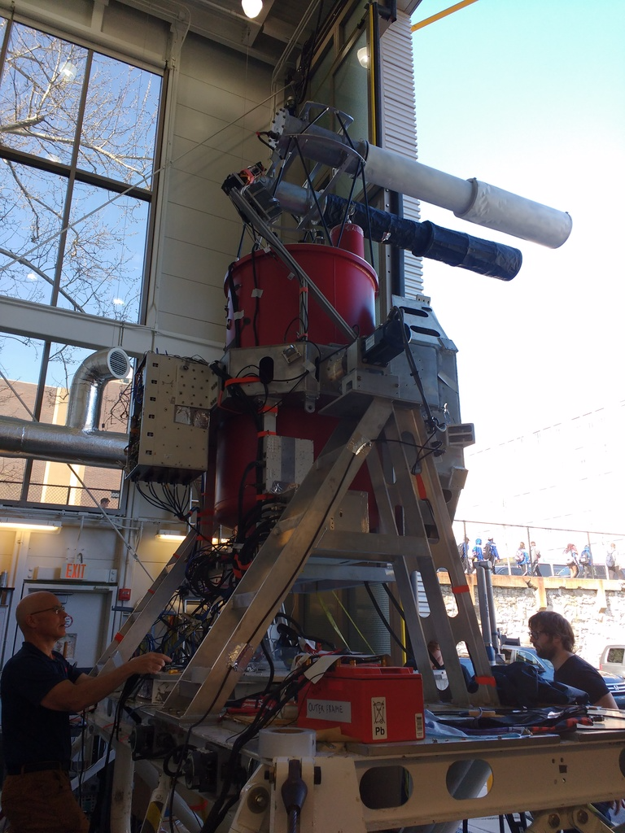
BLAST-TNG in the near future
The upgraded BLAST-TNG will fly from Antarctica in December 2018.
  Same submm bands, but with longer hold time and improved sensitivity.
Targets include:
  9 dense GMCs in which physical scales of ~0.1 pc will be resolved.
  ~50 deg² of diffuse ISM fields (A_{V} < 1) with resolution 1 – 5 arcmin.
Expect hundreds of thousands of 3σ polarization measurements.

Slide 13
How will PICO help?
Spectral resolution
  For typical diffuse clouds, PICO will make 3σ measurements of 2% polarization in 9 bands. (compare vs. 4 bands for BLASTPol+Planck353)
  Any non-monotonic pol spec tells us something interesting about grain populations and/or environment, but also look for variations in slope, curvature, dependencies of β, etc.
Spatial resolution
  Analysis shown so far has been averaged over a cloud, or several objects combined.
  PICO will let us connect large-scale properties -> cloud scales -> star-formation scales (0.1 pc in nearest GMCs)
Statistics!
  Highest frequency band covers entire sky at 5’ resolution, 70% at 1’ resolution.
  Correlate dust polarization signal with N, T, β, B-fields, lat, lon, velocity, metallicity, spectral lines, etc., etc. etc.

Slide 14
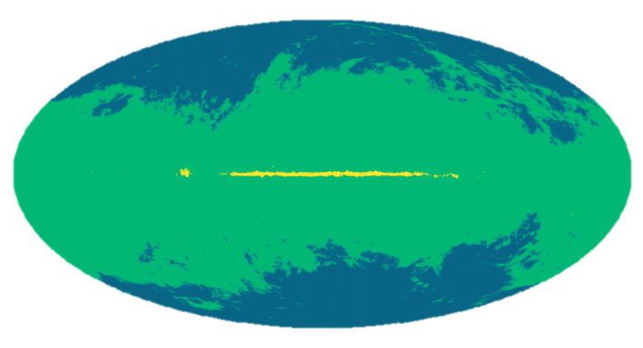
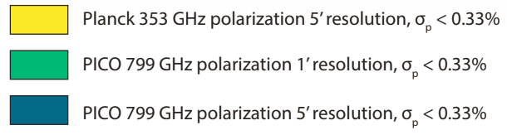
Dust is everywhere…
Planck Thermal Dust

