Slide 1
Sub-Kelvin Cooling Options for PICO
Peter Shirron
Cryogenics and Fluids Group, Code 552
NASA/Goddard Space Flight Center
Greenbelt, MD 20771 USA

Slide 2
Sub-Kelvin Cooling Options
Primary coolers
⁴He JT
³He JT
Pulse tube cooler
Helium Dewar
^{Turbo Brayton}
Sub-kelvin
⁴He sorption cooler
TRL 6
Single-stage ADR
³He sorption cooler
Multi-stage ADR (single-shot and continuous)
Two-stage ADR
Single-stage ADR
TRL 4
Closed cycle DR
Open cycle DR
NIS chip

Slide 3
Continuous Sub-Kelvin Coolers
Dilution Refrigerator
  Open-cycle DR: Planck
  Closed-cycle DR: under development for Athena
Adiabatic Demagnetization Refrigerator
  3-stage ADR (continuous plus single-shot): Astro-H
  Continuous ADRs for cooling at ~1 K and ≤100 mK
Tentative PICO requirements
  16 µW at 100 mK
  ~1 mW at 1 K
    Temperature to be optimized based on eventual instrument details

Slide 4
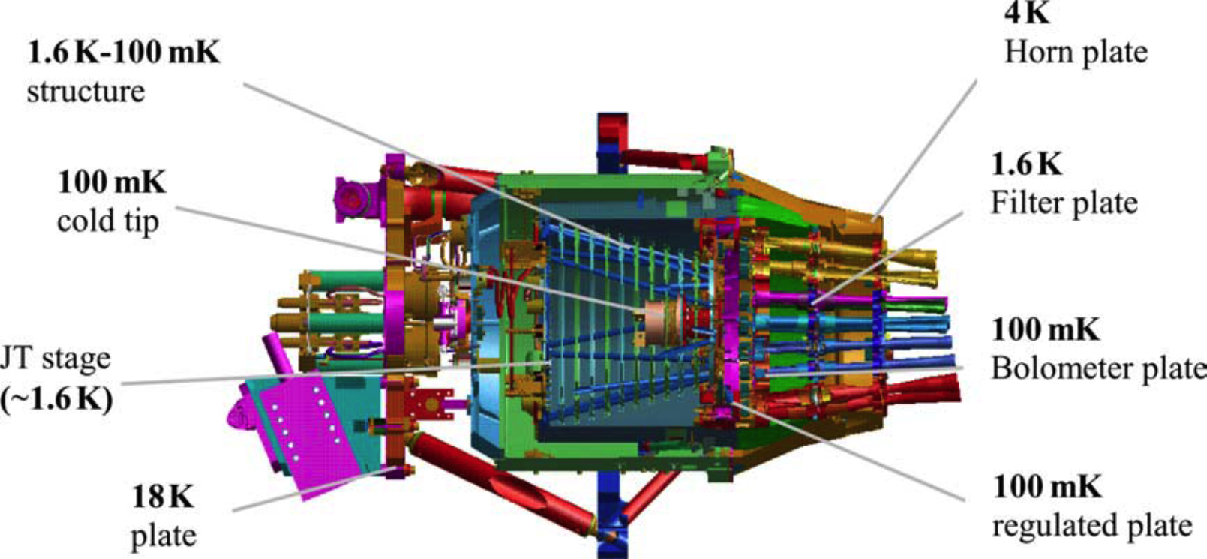
Planck OCDR
Open cycle version is first to work in zero-g
  Continuous, stable T, low cold mass
Launched in May 2009, operated for 2.6 years
300 K
JT
expansion
Planck Cooling System
Mixing is equivalent to evaporation of ³He
Courtesy Gerard Vermeulen

Slide 5
OCDR Concept
300 K
Planck Performance:
Cooling power: 0.2 𝜇W at 100 mK
Lifetime: 2.5 years
Helium flow rate:
    ³He 6 𝜇mol/s
    ⁴He 18 𝜇mol/s
High pressure storage on satellite:
    ³He 12 m³ STP
    ⁴He 36 m³ STP
Auxiliary cooler
JT
expansion
Scaling to lower temperature and higher cooling power results in excessive mass
- Need to close the cycle
Notes:
This cooler provided 0.2 microWatt at 100 mK in a 100% duty
In order to reach this performance, the flow rates of 3He and 4He were adjusted to 6 and 18 micromol/s. The life time of 2.5 years is set by the initial amount of fluids stored on the satellite.

Slide 6
Closed Cycle Dilution Refrigerator
External ³He pump
Key Features:
Still with a liquid-vapor interface in zero-g
⁴He circulation with fountain pump
External pump for ³He circulation
Optimized CFHXs to go below 50 mK
Requires auxiliary cooling at 4.2 K and 1.7 K
Benefits:
  Continuous cooling
  No magnetic fields
  Multiple fixed temperature heat intercepts
Notes:
Here are summarized the technical key points to developed the closed cycles dilution refrigerator.

Slide 7

Prototype Closed Cycle DR
Test conditions
3He pump outside cryostat
Simulated 1.7 K interface with pumped pot
Performance
53.4 mK with 1.0 𝜇W load
  ${\dot{Q}}_{leak}=$ 0.8-1.2 𝜇W
5-6 𝜇W at 100 mK
$>$ 40 𝜇W at 300 mK on CFHX 2-3 junction
Critical steps for EM
JAXA or U. Twente 3He pump
JAXA 1.7 K cryocooler
Improved heat exchangers
Notes:
Here is a picture and a schematic of this last prototype. We can see the different components I've been talking about.
We can notice large thermal anchors at low temperature to improve temperature stability and a structure made of carbon tubes to test future materials.

Slide 8
ADR Cycle
Based on the magnetocaloric effect
  Paramagnetic materials will warm/cool under influence of increasing/decreasing magnetic field
Inherently single-shot, BUT… reversible, so intrinsically high efficiency
Isothermal demagnetization
Adiabatic demagnetization
Isothermal magnetization
Adiabatic magnetization

Slide 9
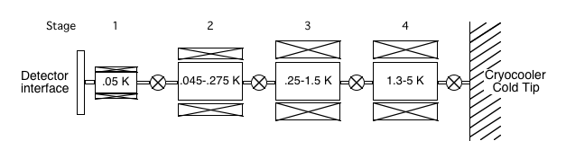
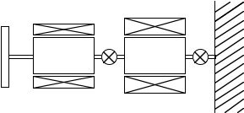

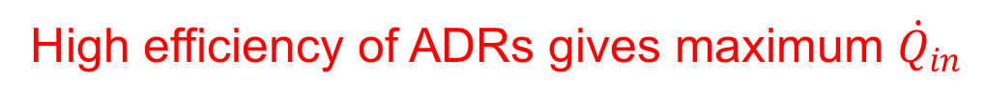
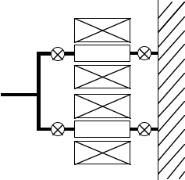
Continuous Cooling with an ADR
Two (or more) stages can be used to generate continuous cooling
Two configurations
  Serial
    Heat is cascaded through upper stage(s)
  Parallel
    Stages alternate role in cooling load and rejecting heat
f~0.6-0.7
4-stage CADR
f~0.3
$${\dot{Q}}_{in} limited by {\left\langle {\dot{Q}}_{out}\right\rangle =f•{\dot{Q}}_{out}}_{peak}$$
High efficiency of ADRs gives maximum ${\dot{Q}}_{in}$

Slide 10
Proposed PICO ADR configuration
2-stage parallel CADR operating at 1 K
3-stage series CADR operating at 0.1 K

Slide 11
2-Stage Parallel CADR
Heat rejection at 4.5 K
Stages equivalent to upper stages built for Astro-H
Cooling power depends on available cooling at 4.5 K
  Nominal total is 40 mW
  Astro-H: 10 mW static load
2-stage series CADR demonstrated on Astro-H
  ~1 mW at 1.5 K

Slide 12
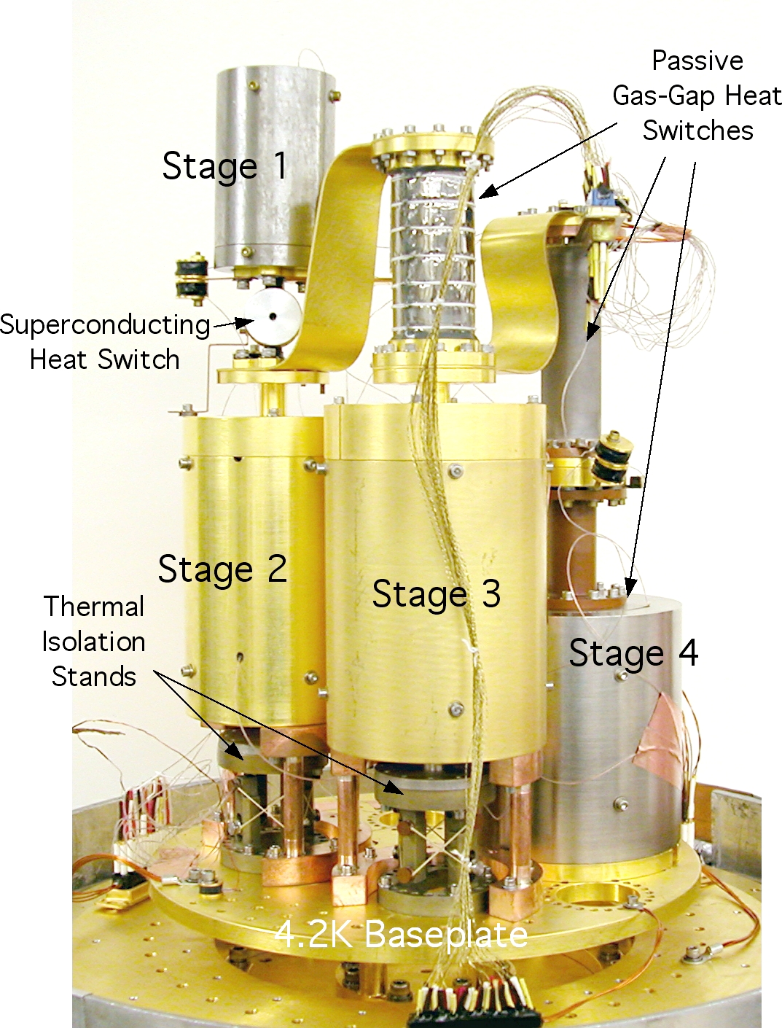
3-Stage Series CADR
Performance will exceed that obtained for the 4-stage CADR
  Lower parasitic heat loads

Slide 13
Temperature Stability at 100 mK
Periodic heat flows can generate temperature disturbances at cold stages
Options for reducing magnitude of disturbances
  Reduce cycle speed -> reduces cooling power
  Feedforward control: use knowledge of changes in heat flow to calculate changes in magnetization rate

Slide 14
Temperature Stability at 1 K
Astro-H 2-stage series CADR operated at 1.5 K
  Only demonstrated on the ground (no cryogen-free operation during mission)

Slide 15
Summary
PICO requirements: 16 µW at 100 mK, ~1 mW at 1 K
Open-cycle DR
  Critical functionality of the dilution unit has been demonstrated (TRL 4)
  Cooling power not quite at level needed for Athena (1 µW at 50 mK), or PICO (5-6 µW at 100 mK)
  Requires auxiliary cooling at 1.7 K and 4.5 K
Continuous ADRs
  Only high TRL cooler that has demonstrated continuous cooling with suitable cooling power for PICO
  Only requires auxiliary cooling at 4.5 K
  Architecture is very flexible
    Addition of stages can
      Improved temperature stability
      Add constant temperature nodes
      Improve cooling power (by increasing average heat reject rate)

